Slide 1
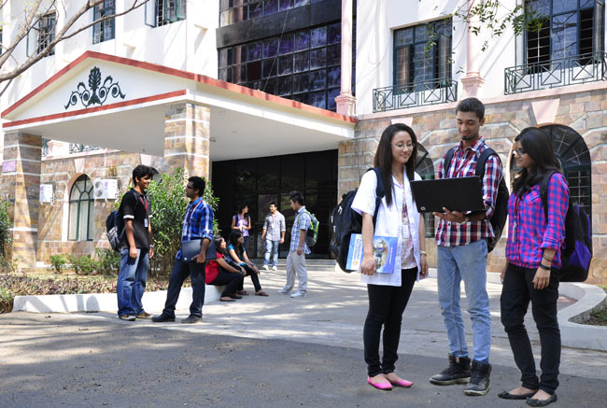

CSB4301 - WEB TECHNOLOGY
B.Tech – V Semester
UNIT III
Dr. Muthukumaran M
Associate Professor
School of Computing Sciences,
Department of Computer Science and Engineering

Slide 2
Introduction to React – Virtual DOM, React element

Slide 3
Setting REACT Environment

Slide 4
Install create-react-app by running this command in your terminal:
C:\Users\Your Name>npm install -g create-react-app
Then you are able to create a React application, let's create one called myreact.
Run this command to create a React application named myreact:
C:\Users\Your Name>npx create-react-app myreact
The create-react-app will set up everything you need to run a React application.

Slide 5
Run the React Application
Now you are ready to run your first real React application!
Run this command to move to the myreact directory:
C:\Users\Your Name>cd myreact
Run this command to run the React application myfirstreact:
C:\Users\Your Name\myreact>npm start
A new browser window will pop up with your newly created React App! If not, open your browser and type localhost:3000 in the address bar.

Slide 6
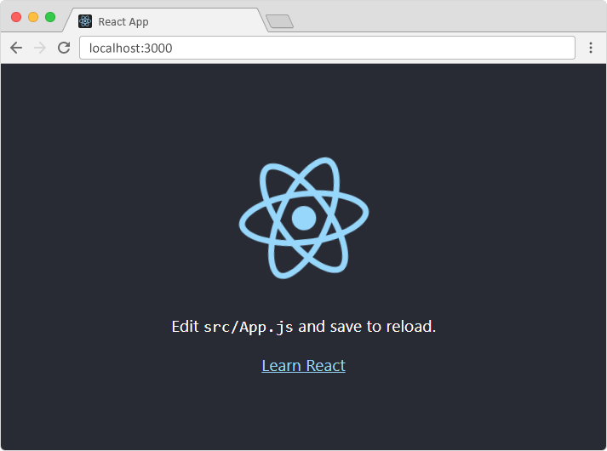

Slide 7
Modify the React Application
Look in the myreact directory, and you will find a src folder. Inside the src folder there is a file called App.js, open it and it will look like this:

Slide 8
/myreact/src/App.js:
import React, { Component } from 'react';
import logo from './logo.svg';
import './App.css';
class App extends Component {
render() {
return (
<div className="App">
<header className="App-header">
<img src={logo} className="App-logo" alt="logo" />
<p>
Edit <code>src/App.js</code> and save to reload.
</p>
<a
className="App-link"
href="https://reactjs.org"
target="_blank"
rel="noopener noreferrer"
>
Learn React
</a>
</header>
</div>
);
}
}
export default App;

Slide 9
Example
Replace all the content inside the <div className="App"> with a <h1> element.
See the changes in the browser when you click Save.
import React, { Component } from 'react';
class App extends Component {
render() {
return (
<div className="App">
<h1>Hello World!</h1>
</div>
);
}
}
export default App;

Slide 10
What's Next?
Now you have a React Environment on your computer, and you are ready to learn more about React.
If you want to follow the same steps on your computer, start by stripping down the src folder to only contain two files: index.js and index.html, in some builds you might find the index.html in the public folder instead, you should also remove any unnecessary lines of code inside the two files to make them look like the files in the Show React tool below:

Slide 11
index.js:
import React from 'react';
import ReactDOM from 'react-dom';
const myfirstelement = <h1>Hello React!</h1>
ReactDOM.render(myfirstelement, document.getElementById('root'));
index.html:
<!DOCTYPE html>
<html lang="en">
<head>
<meta charset="utf-8" />
<meta name="viewport" content="width=device-width, initial-scale=1" />
<title>React App</title>
</head>
<body>
<div id="root"></div>
</body>
</html>

